Slide 1

My Artificial Intelligence Course Journey
Name: Sonia Akther Mufsina
University: North East University Bangladesh
Department: Computer Science and Engineering
Instructor: Razorshi Prozzawal Talukder

Slide 2


Course Overview
Curriculum
Schedule
Core topics and modules
Timeline and weekly plan
Assessment
Resources
Assignments and exams
Readings and tools provided
Comprehensive Learning
Practical Implementation
Core Understanding
Learned both AI theory and lab-based practicals
Implemented multiple AI algorithms and developed 3 games
Gained understanding of intelligent behavior in machines

Slide 3

Introduction to Artificial Intelligence
Defining AI
AI: Systems that think and act intelligently
Difference between AI, ML, and DL
Goals of AI
Problem-solving
Automation
Decision-making
Key Applications
Robotics
Healthcare
Gaming
Security

Slide 4

Agents and Environments
Perceive
Agent senses environment state
Decide
Agent selects action based on model
Agent ↔ Environment
Interaction loop of perception and action
Act
Agent executes chosen action
Percepts
Environment returns feedback
Agents
Environment Types
Agents: Perceive environment & take actions
Fully/Partially observable
Agent Types
Deterministic
Simple Reflex
Dynamic
Model-Based
Goal-Based
Utility-Based

Slide 5
Algorithms Learned (Theory Class)
Focus: Problem-solving & state-space representation
Search Algorithms
Heuristic Algorithms
Game Algorithms
BFS, DFS
Best-First, Beam, Hill Climbing
Min-Max
Depth-Limited, Iterative Deepening
A0*, A*
Alpha-Beta Pruning
Bidirectional

Slide 6
Algorithms Learned (Lab Class)
Implemented in Python
Tested input/output cases for accuracy
Uninformed Search
Informed Search
Adversarial Search
BFS, DFS, Depth-Limited, Iterative Deepening, Bidirectional
Best-First, Beam, A*
Min-Max, Alpha-Beta

Slide 7
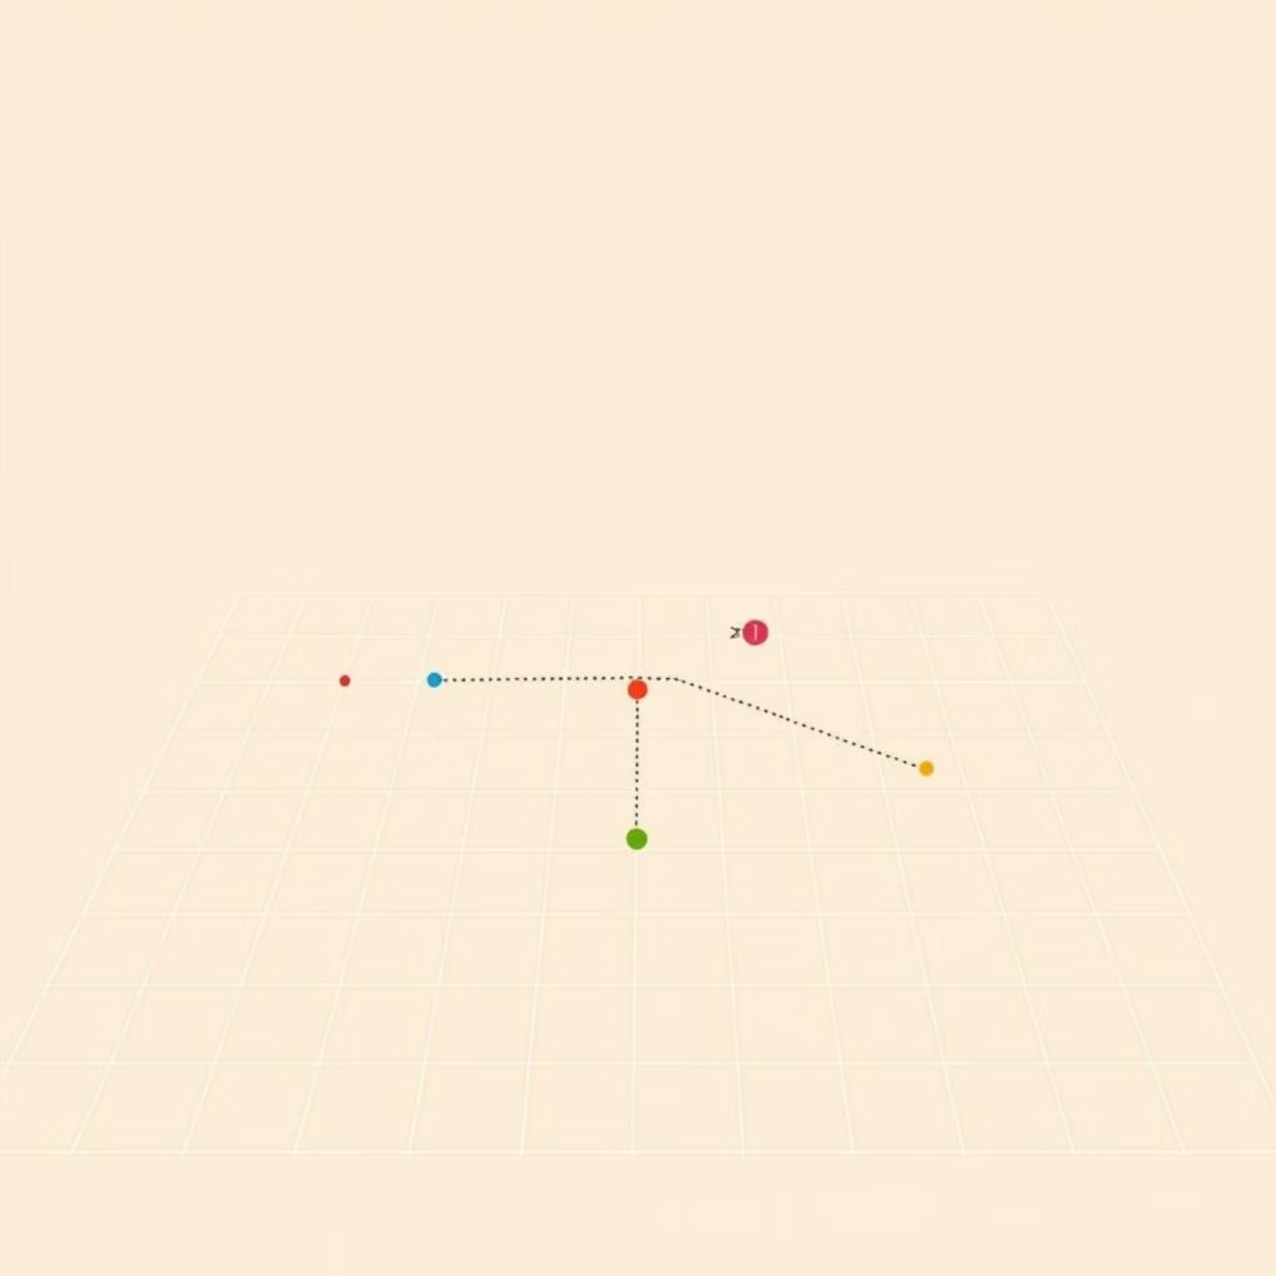
A Search Algorithm*
Key Features
Pathfinding algorithm using heuristic cost
Finds the optimal path efficiently
Complexity: O(b^d)
Applications
Maps
Robotics
Route Optimization

Slide 8
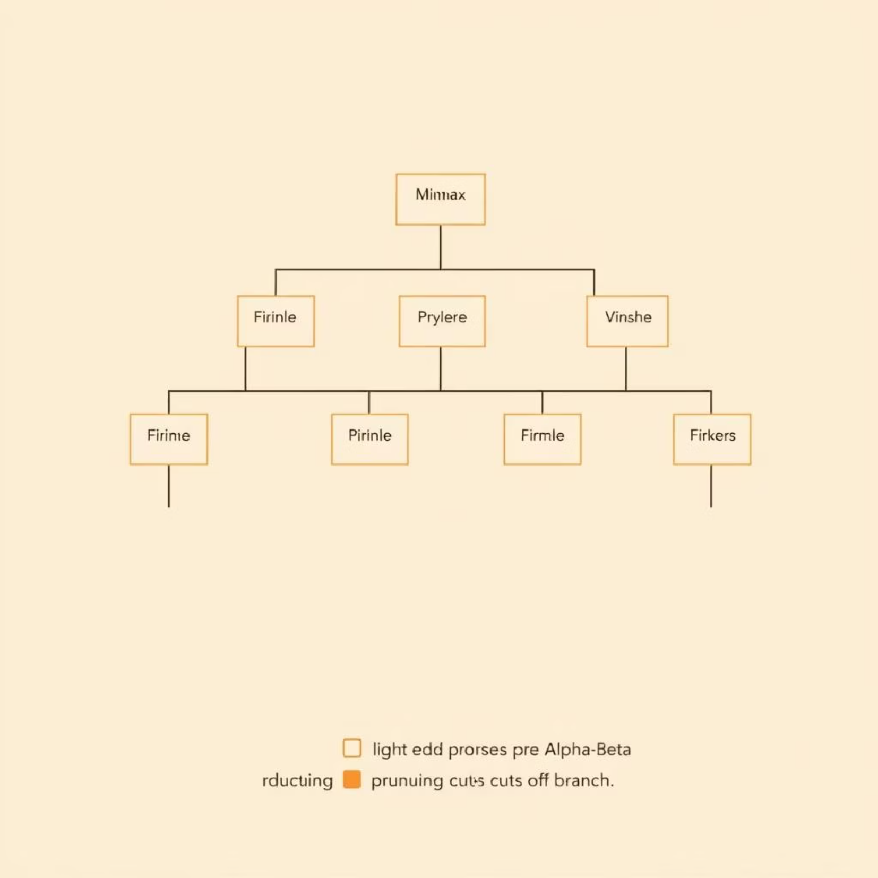
Min-Max & Alpha-Beta Pruning
Min-Max Algorithm
Min-Max: Decision-making for two-player games
It assumes the opponent plays optimally to minimize the player's score.
Alpha-Beta Pruning
Alpha-Beta: Optimized Min-Max (prunes unnecessary branches)
Significantly reduces the number of nodes searched in the game tree.
Applications
Tic Tac Toe
Chess

Slide 9
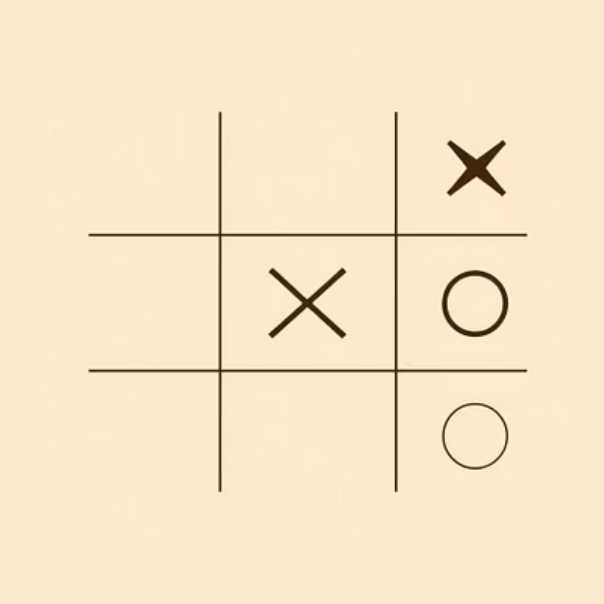
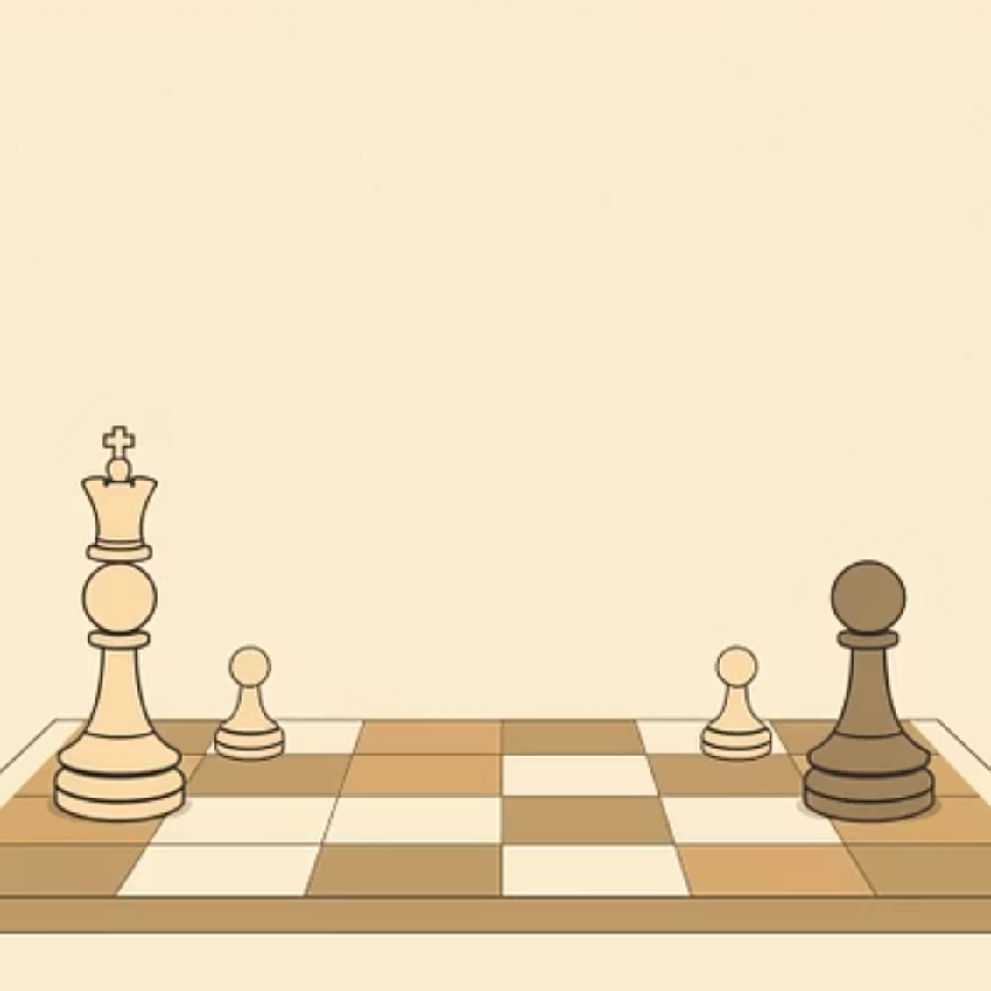
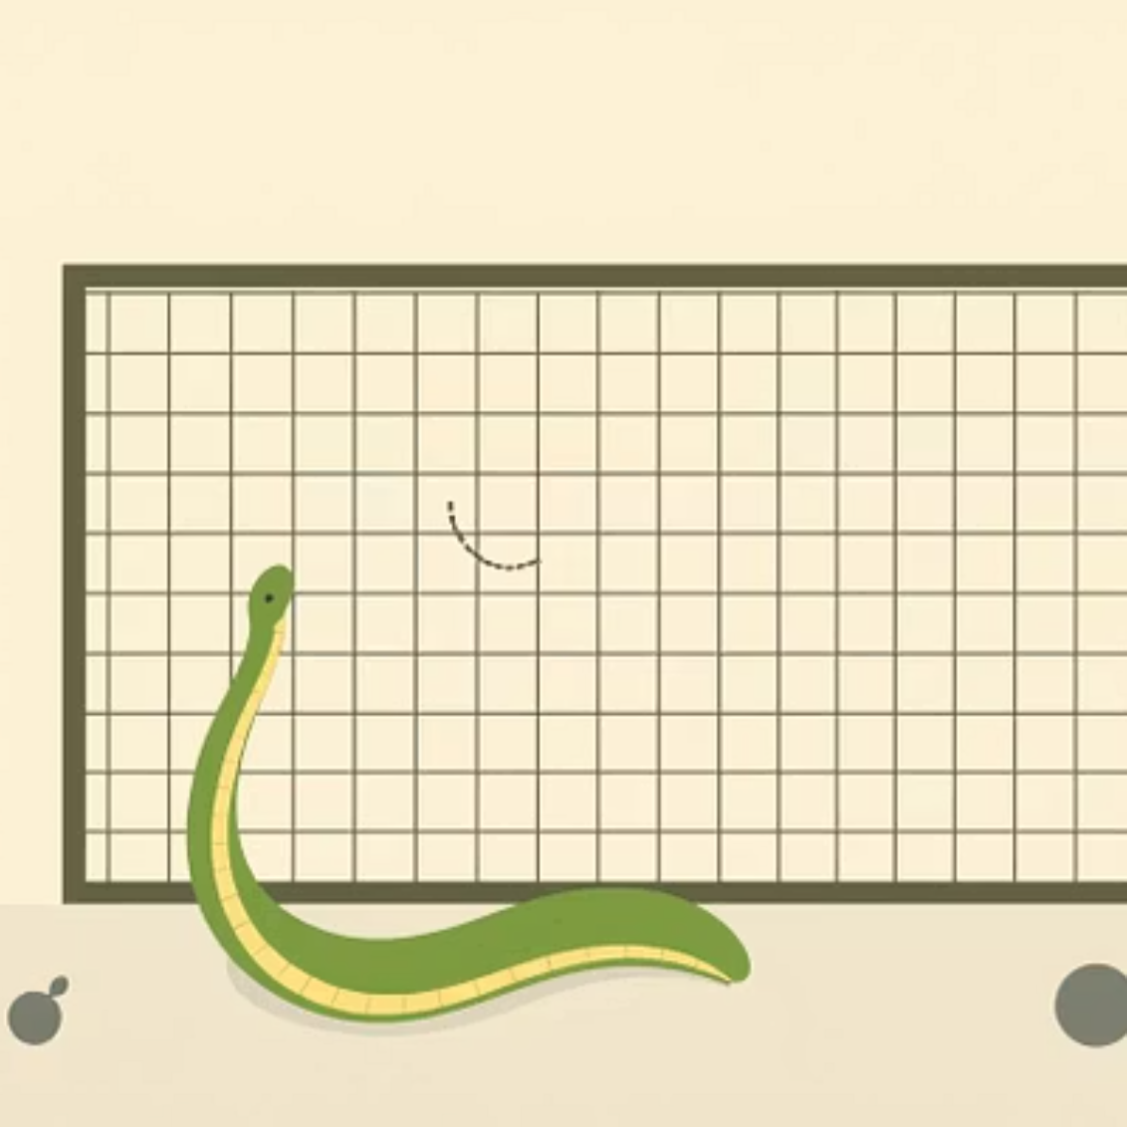
AI Games (Lab Projects)
Tic Tac Toe
Chess
Snake Game
AI vs Human using Min-Max / Alpha-Beta
Strategic AI gameplay using Min-Max
AI logic for movement, food detection, and collision avoidance

Slide 10
Key Learnings & Acknowledgment
Practical Confidence
Technical Skills
Conceptual Mastery
Built confidence in applying AI practically
Gained coding experience and problem-solving skills
Learned AI concepts, search algorithms, and game logic
Instructor: Razorshi Prozzawal Talukder
“Created using AI Tools by Sonia Akther Mufsina”

